Slide 1
Data Driven
The Role of Biostatistics in Cancer Research & Health Policy
September 13, 2019
Renee L. Gennarelli, MS
Research Biostatistician Center for Health Policy & Outcomes
Jessica A. Lavery, MS
Research Biostatistician Biostatistics Service
Department of Epidemiology & Biostatistics

Slide 2
biostatistics bi·o·sta·tis·tics (bī'ō-stə-tĭs'tĭks)
noun. The science of statistics applied to the biological and health sciences.

Slide 3
What questions does biostatistics help answer?
Should a new drug be approved by the FDA?
Where should a government invest its resources to reduce infant mortality?
Should a breast cancer patient receive chemotherapy prior to undergoing a mastectomy?
Notes:
Types of biostats jobs:
-Research & policymaking: govt, academia, research hospitals
-Industry: pharma companies, consulting, CROs, private healthcare orgs

Slide 4


Memorial Sloan Kettering Cancer Center
Oldest and largest private cancer center in the world.
Memorial Hospital
Sloan Kettering Institute
Consistently ranked as one of the top 2 cancer hospitals by US News & World Report.
Treat over 400 different types of cancer each year
Currently leading over 1,100 clinical research studies
www.mskcc.org
Notes:
Put additional MSK facts here
Mention biostats core
Between 1980 and 2012, the FDA approved 9 drugs developed at MSK for marketing — a success rate not matched by any other cancer center.

Slide 5
Department of Epidemiology and Biostatistics
Chair of Biostatistics Department
Principal Biostatisticians (PhD/DrPH)
Chief of Biostatistics Department
Faculty statistician: Master’s group supervisor
Research biostatisticians (MS)
Faculty statisticians (PhD’s)
Data analysts (BS)

Slide 6
Master’s level track in Epi-Bio
Assistant Research Biostatistician
Research Biostatistician I
Research Biostatistician II
Senior Research Biostatistician

Slide 7
So, what exactly do we do and how did we get here?

Slide 8
My journey to MSK
2007-2011
B.A. in Mathematics
School of Computer Science & Math
2013-2014
Statistical Data Analyst
Division of Public Health Sciences
2014-Present
Research Biostatistician
Center for Health Policy & Outcomes
2012-2013
M.S. in Biostatistics
School of Medicine

Slide 9
Center for Health Policy & Outcomes
Goal: develop evidence-based policy approaches that improve patient outcomes
Analyzes the healthcare systems through which cancer care is delivered
Observational Research
NCI’s Surveillance and Epidemiology End Results Program (SEER) cancer registry
Medicare claims and discharge data
Collaborative effort involving biostatisticians, epidemiologists,
clinicians and health services researchers.
Notes:
Located within the Department of Biostatistics & Epidemiology
Observational: MSK medical record and billing data
Private insurance claims

Slide 10
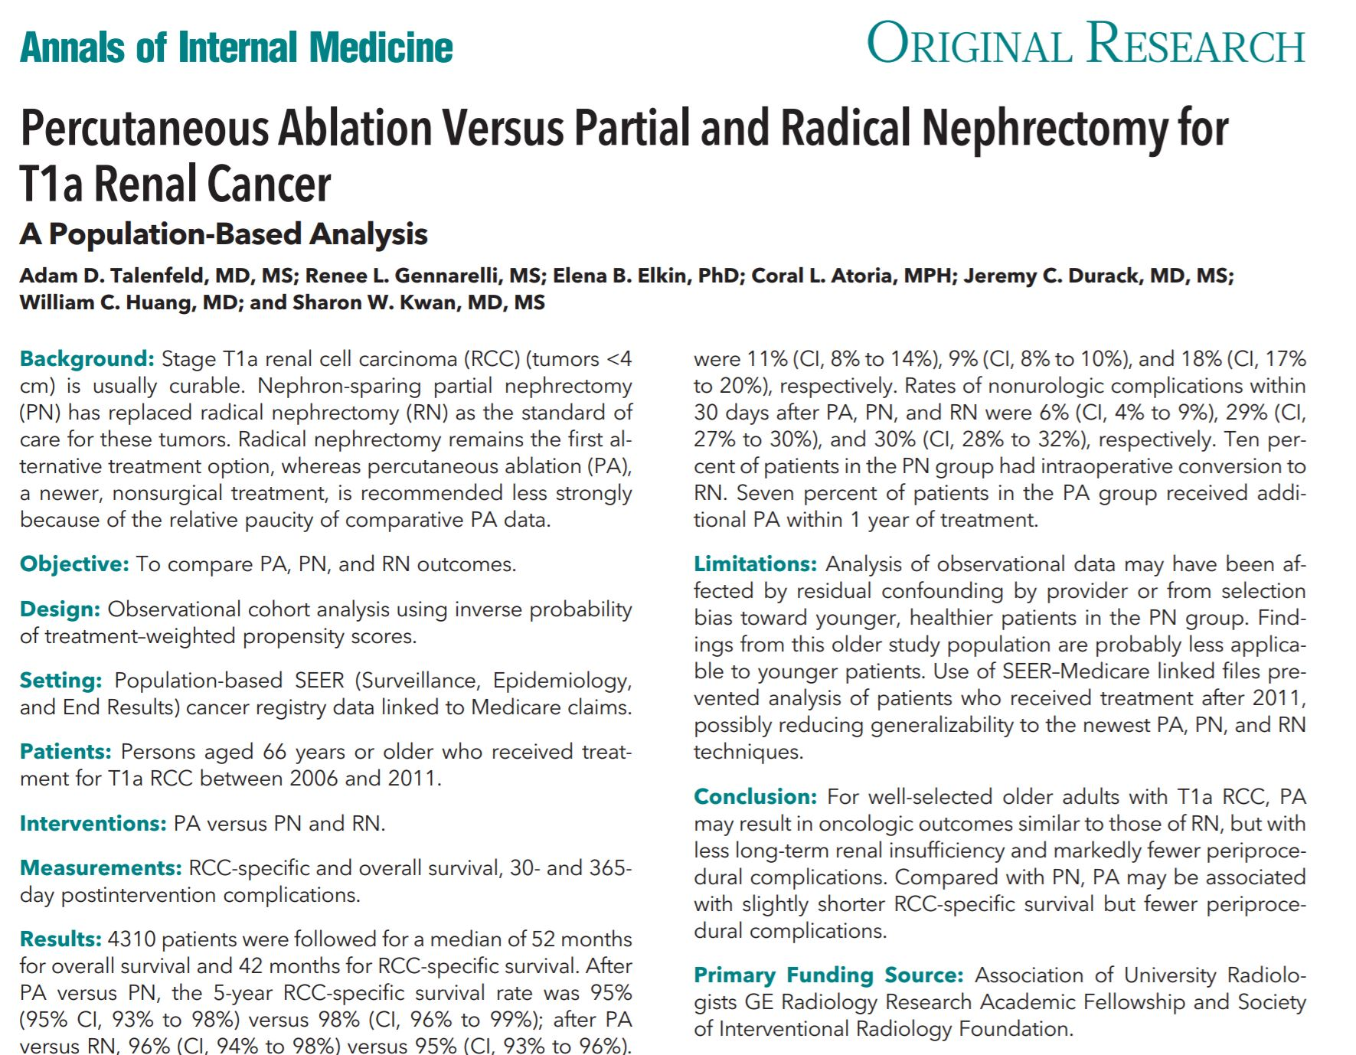
Notes:
SEER-Med
-showed that a less invasive procedure has similar survival and less complications – will directly impact practice

Slide 11
Center for Health Policy & Outcomes
Goal: develop evidence-based policy approaches that improve patient outcomes
Analyzes the healthcare systems through which cancer care is delivered
Observational Research
NCI’s Surveillance and Epidemiology End Results Program (SEER) cancer registry
Medicare claims and discharge data
Drug Pricing Lab
explore pharmaceutical pricing and reimbursement policy landscape
Drug pricing & health insurance reform
Collaborative effort involving biostatisticians, epidemiologists,
clinicians and health services researchers.
Notes:
DPL also includes health economists
-this gets us in the most trouble

Slide 12
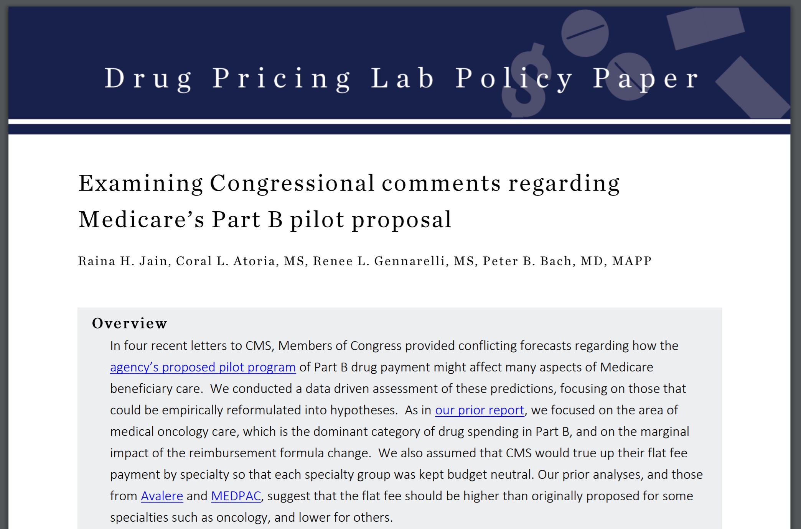

Slide 13
Center for Health Policy & Outcomes
Goal: develop evidence-based policy approaches that improve patient outcomes
Analyzes the healthcare systems through which cancer care is delivered
Observational Research
NCI’s Surveillance and Epidemiology End Results Program (SEER) cancer registry
Medicare claims and discharge data
Drug Pricing Lab
explore pharmaceutical pricing and reimbursement policy landscape
Drug pricing & health insurance reform
Comparative Effectiveness Research
Policy relevant clinical questions
Collaborative effort involving biostatisticians, epidemiologists,
clinicians and health services researchers.
Notes:
A high profile example of this type of research within the Center led to MSK rejecting the colorectal cancer drug ziv-aflibercept (Zaltrap®) from its formulary, after determining it was no better than a drug that cost half its price. This action was covered by The New York Times and on 60 Minutes.

Slide 14
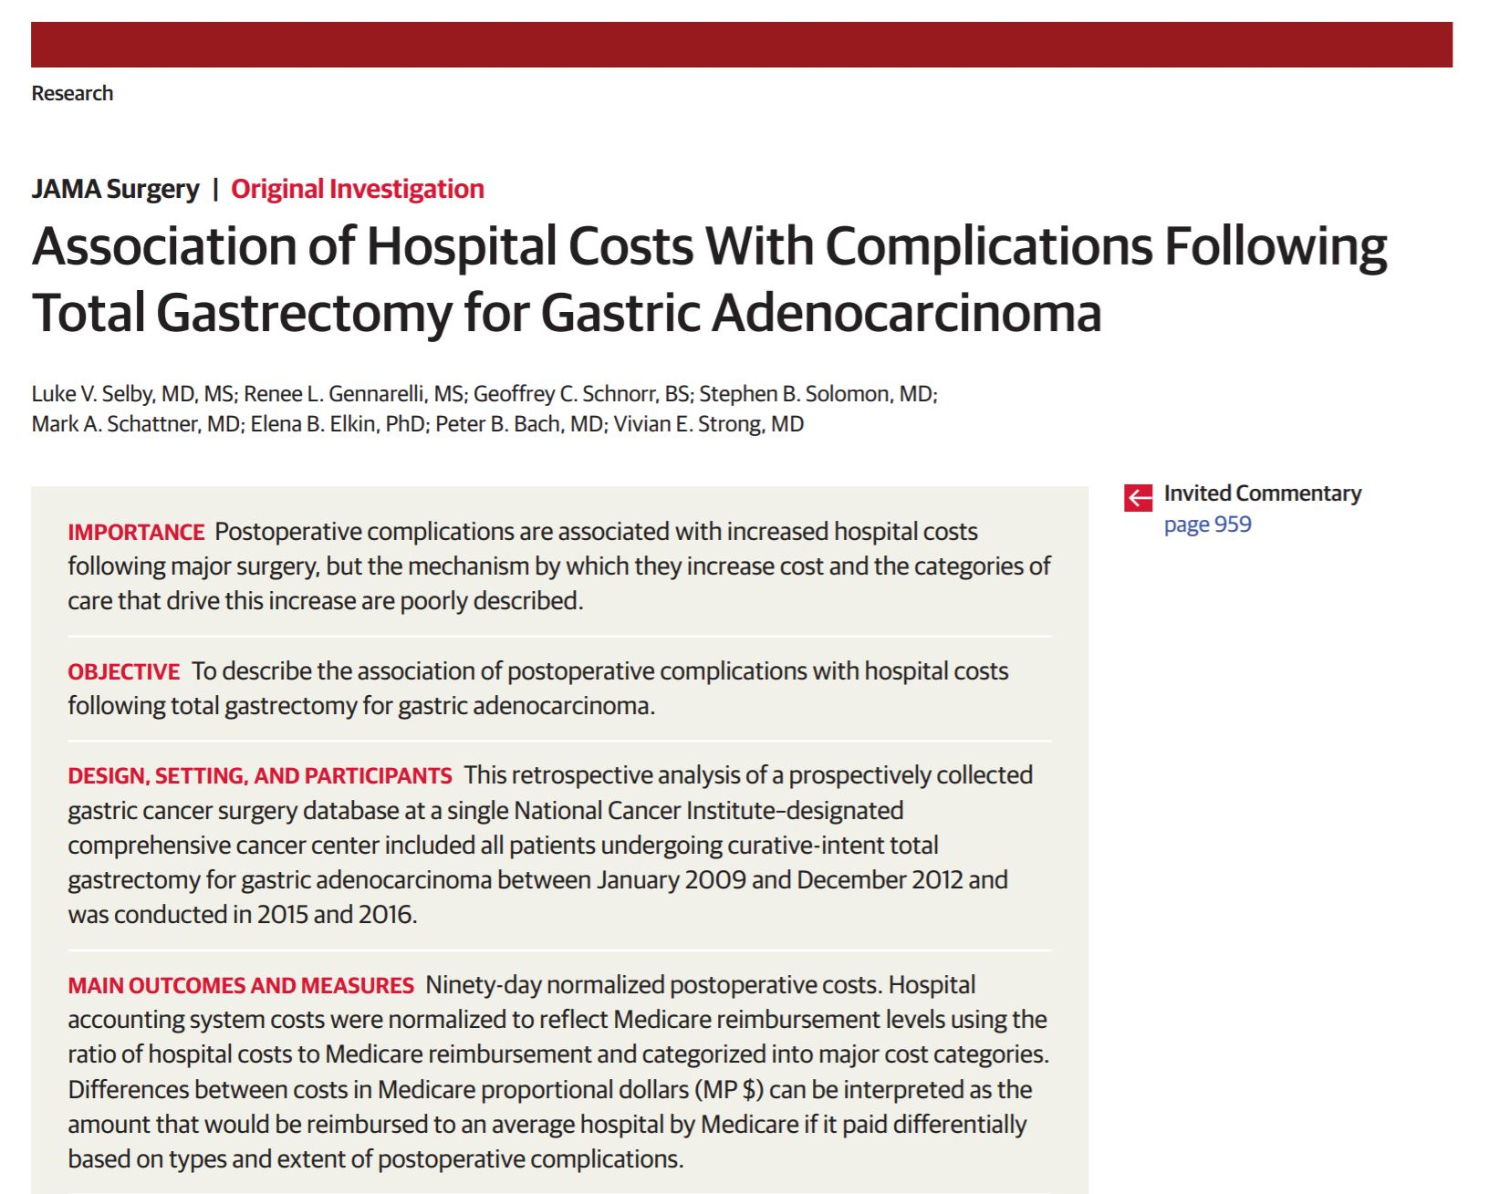
Notes:
MSK Cost Data – showed treatment of complications drives most cost – institution has initiative to reduce complications and helps understand cost allocation for resources

Slide 15
Statistical Evaluation of Oncology Drug Trial Portfolios & the Potential for Inappropriate Regulatory Approval
Current Work

Slide 16
FDA drug approval used to require replication of positive study findings in subsequent clinical trials.
Now, treatments can be approved based on the results of just one trial
Speeds access to new treatments
Economically beneficial for drug companies
If even one of these trials produces false positive findings, a drug could be brought to market that is ineffective
How often could this be happening among the current cancer drug trials?
If a drug has no treatment benefit, what is the chance that it could be approved and how big of a false treatment effect could be shown?

Slide 17
Results: Exploring Type 1 Error
Drug=pembrolizumab
Phase=2 or 3
Arms=2
Censoring time=[0,36]
Arm 1 (control) Median Survival=10 months
Arm 2 (pembro) Median Survival=10 months
1000 simulations
Notes:
Mention that our test dataset came from immunotherapy trials identified in The Cancer Letter

Slide 18
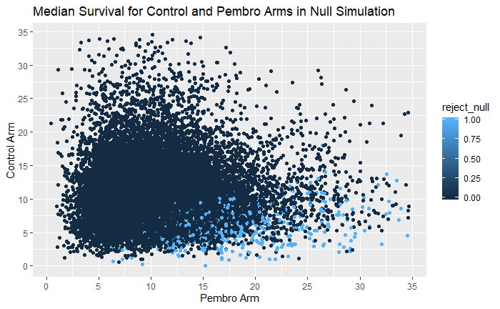
Simulated Portfolio
41 trials x 1,000 simulations = 41,000 trials
Type 1 error rate per trial ~0.025 as expected
Notes:
413/1180 sig trials were stopped early
Some significant trials showed a median survival benefit of 20+ months

Slide 19
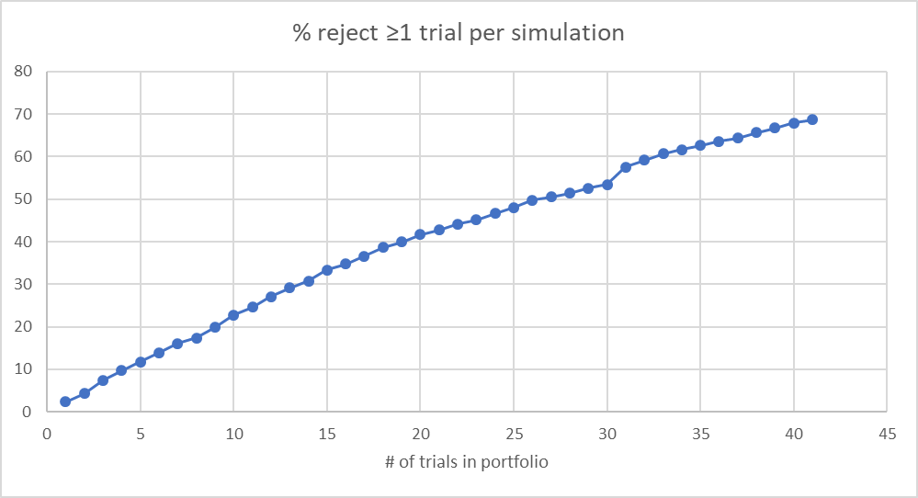
What is the chance of rejecting the null for at least one trial in the portfolio?
Notes:
Rejecting avg of 1.18 trials per sim : ~35% 1 trial, ~20% 2 trials, ~10% 3 trials, ~5% 4-7 trials

Slide 20





How I got to MSK
2014-2016
2008-2012
2012-2014
2016-2017
2017-

Slide 21

What’s next?
And then…?
2019-2023 (ish): Classes
2023-2025?: Dissertate

Slide 22
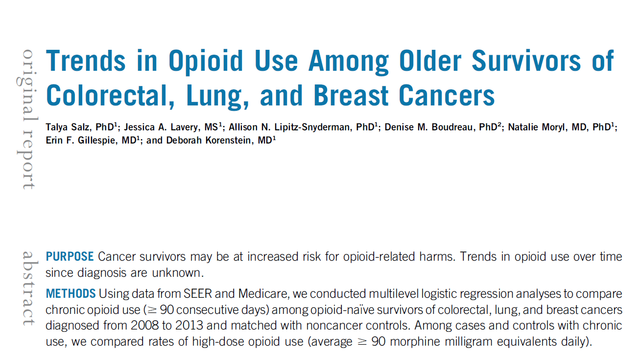
Previous projects

Slide 23
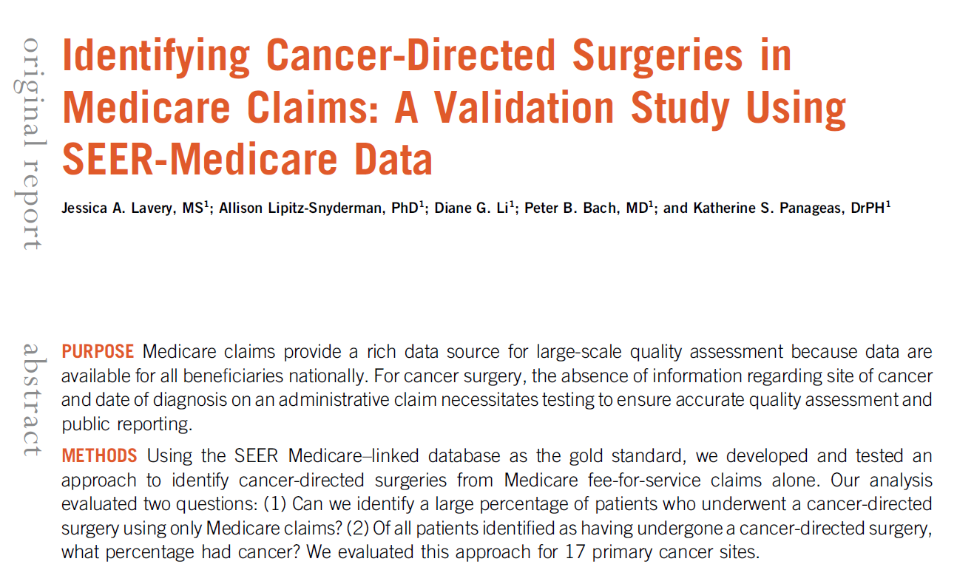

Slide 24
Current projects
Retrospective studies using large, administrative datasets
Does the number of patients that a chemotherapy provider sees affect outcomes (toxicity, survival) to patients with gynecologic cancers?
Do head & neck cancer patients have higher rates of chronic opioid therapy compared to similar patients without cancer?
Retrospective studies using institutional data from MSK
Is the SMARCA4 biomarker associated with survival in patients with lung cancer?
How do different doses and formulations of a particular chemotherapy affect toxicity and ocular survival in pediatric patients with retinoblastoma?
What factors are associated with how quickly the immune system recovers following a stem cell transplant? Is faster immune recovery associated with improved survival? (multiple projects in different populations and after different types of stem cell transplants)
Describe the quality of life among melanoma patients that received immunotherapy.
Clinical trials
Can exercise be used to target cancer cells and improve survival? (multiple protocols)
Do team-based exercise interventions result in increased physical activity in kids with cancer?

Slide 25
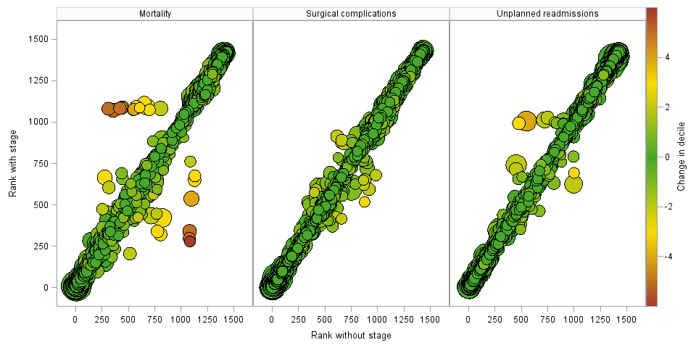
Hospital profiling project: Does hospital rank change after adjusting for cancer stage?

Slide 26
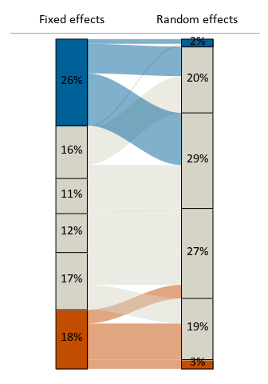
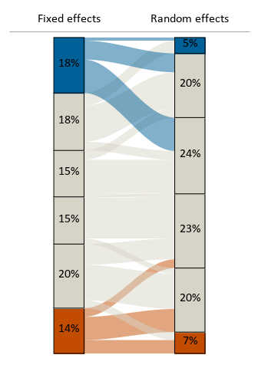
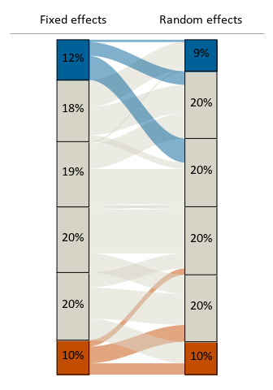
Hospital profiling project: Hospital ranking based on standardized rates from two different measures, stratified by volume
Volume <=11
Volume <=25
Volume <=100
Notes:
Orientation: Blue = higher rank (better performance), Orange = lower rank (worse performance)
Hospitals grouped into top and bottom decile and remaining quintiles, then stratified by volume
Among hospitals with a volume ≤11
The FE method identified 26% of providers to be in the top decile, 18% of providers to be in the bottom decile, whereas RE methods identified only 2% and 3% of low-volume providers to be in the top and bottom decile, respectively.
We can see that there’s not a lot of movement in the gray bars (middle quintiles) across methods), just that the providers identified in the extreme deciles with FE move towards the middle for RE.
Among hospitals with a volume ≤25
Still a high proportion of “low” (<25) volume providers identified in the extremes with FE, less so for RE
But can now see that the % of providers moving from the extremes to the middle from FE to RE is decreasing, as demonstrated by the width of the blue and orange flows at the top and bottom
Among hospitals with a volume ≤100 (almost all hospitals)
Even less movement from the extremes to the middle from FE to RE
More similar distribution of ranked groups across methods
Conclusion: Similar to the weighted kappa figure, we can see that with increasing volume, FE and RE are in better agreement though there is still some movement from the extremes to the middle from FE to RE.
Less movement from extremes in RE to middle of FE

Slide 27
Expectations

Slide 28
Expectations
Reality

Slide 29
A day in the life
Data management + data analysis (R/SAS)
Retrospective studies
Clinical trials
Protocol development for new prospective studies
Write manuscripts for peer-reviewed journals (methods, results and careful editing of discussion)
Meet with collaborators
Prepare presentations for conferences
MSK
R User’s Group (RUG)
Master’s Seminar
Coding workshop
Open study forum
Guest lectures/departmental seminars
Protocol review meetings
Other MS-level statisticians work on
Developing R packages for use across MSK departments
Genomics analyses

Slide 30
Protocol development
Necessary to plan a study and pre-specify analyses that will be conducted
Key sections:
Objectives & scientific aims
Background & rationale
Overview of study design/intervention
Inclusion/exclusion criteria
Randomization (if relevant)
Biostatistics
Analysis plan, sample size justification for primary objectives
Analysis plan for secondary objectives
Data and safety monitoring
Undergo departmental review by every department involved in the study (Medicine, Nursing, Biostatistics, etc.)

Slide 31
So you want to become a biostatistician…

Slide 32






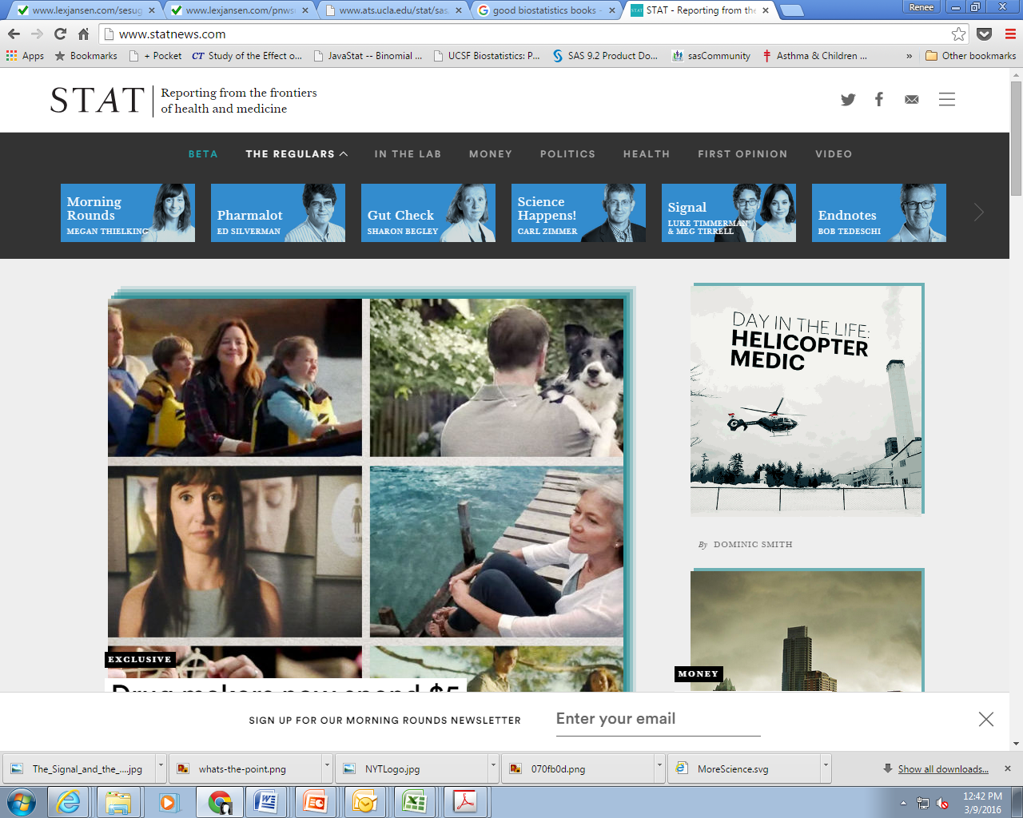

Step 1: Become a data nerd and join the stats community!
Notes:
SIBS: http://www.nhlbi.nih.gov/research/training/summer-institute-biostatistics-t15
Programs still recruiting – BU, MN, Emory

Slide 33



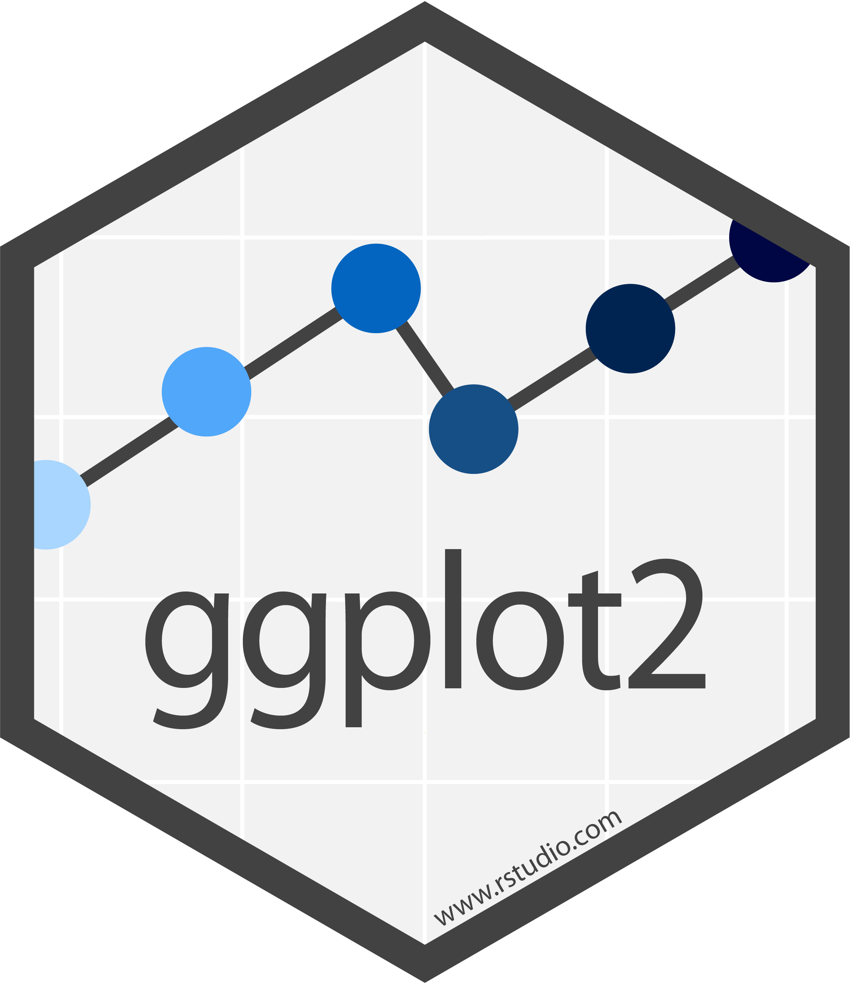










Frequently used R packages
Notes:
https://github.com/rstudio/hex-stickers/tree/master/PNG
http://hexb.in/

Slide 34











Step 2: Get a Masters (or a PhD!)

Slide 35









Step 3: Go to conferences and never stop learning & networking!
International
Conference on
Health Policy
Statistics

Slide 36
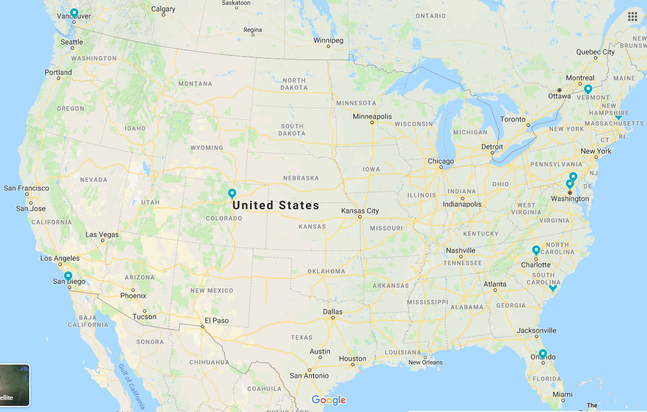






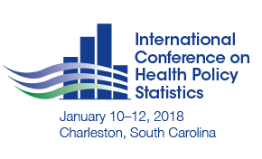
Perk: Explore the US!

Slide 37
“The best thing about being a statistician is that you get to play in everyone's backyard.”
John Tukey

Slide 38
Thank you!
Renee L. Gennarelli, MS
gennarer@mskcc.org
Jessica A. Lavery, MS
laveryj@mskcc.org

